Slide 1

Node.js Literal, operator
Unit 1

Slide 2
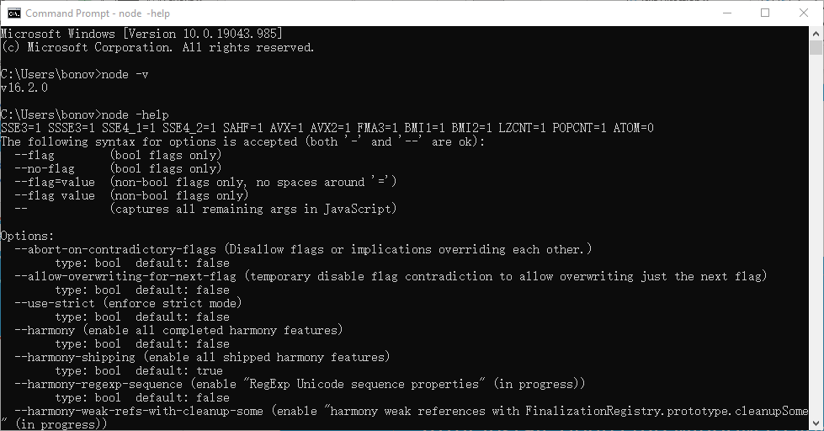
NODE.JS
Download: https://nodejs.org/
Install
After install, open cmd window to verify. Use process.exit() to exit node.

Slide 3
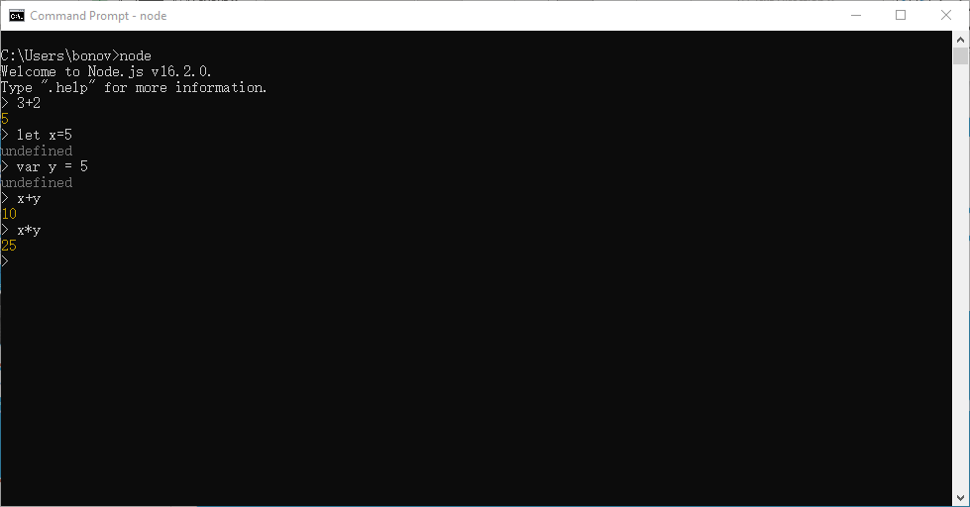
REPL - interactive environment
open cmd window, and run node.
Can type in javascript code to run and get immediate result.
.exit to exit REPL
‘_’ to get last result

Slide 4
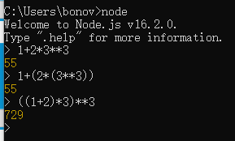
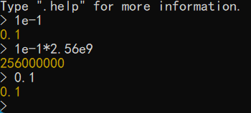
Number value, and arithmetic operators
Integers (Numeric literal). Hex, Octal number. Decimal literal (with a ‘.’). Scientific notation. You can use many different formats.
Inside JS all are float numbers.
Operator: + - * /
Operator: %
Operator: **
Precedence, parentheses
** first
* / %
+ -

Slide 5
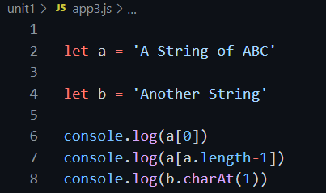

String literal
String literal values can be assigned to variables.
Can use index or charAt() to get specific position character in string.
‘+’ operator will concatenate 2 string into 1 longer string.

Slide 6
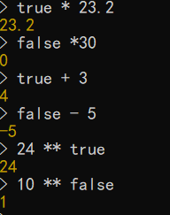
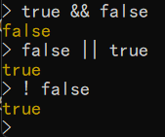
Boolean literal
Only ‘true’ and ‘false’ two values.
In arithmetic operation with number, ‘true’ is same like 1, ‘false is same like 0
Boolean operators: &&(AND), ||(OR), !(NOT)

Slide 7
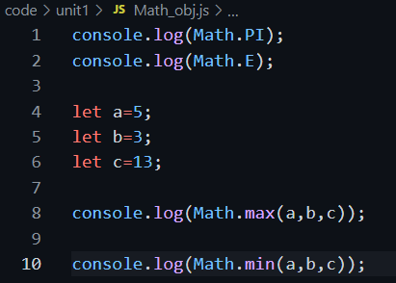
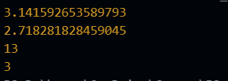
Math object
Math is a built-in object that has properties and methods for mathematical constants and functions. It’s not a function object
Sepcial value: Infinity, NaN
Constants: PI, E
Functions: floor, ceil, exp, random, round, max, min, sin, cos, …

